Slide 1
MULTIPLEXERS
DEMULTIPLEXERS

Slide 2
MULTIPLEXERS (Data Selectors)
A multiplexers (MUX) is a device that allows digital information from several sources to be routed onto a single line for transmission over that line to a common destination.
The basic multiplexers has several data input lines and a single output line. It also has data- select inputs, which permit digital data on any one of the inputs to be switched to the output line.

Slide 3
MUX-continued...
A modern stereo system may have a switch that selects music from one of four sources: a cassette tape, CD, a radio tuner , or an auxiliary input such as audio from a VCR or DVD. The switch selects one of the electronic signals from one of these four sources and sends it to the power amplifier and speakers.
In simple terms, this is what a multiplexer (MUX) does; it selects one of several input signals and passes it on to the output.

Slide 4
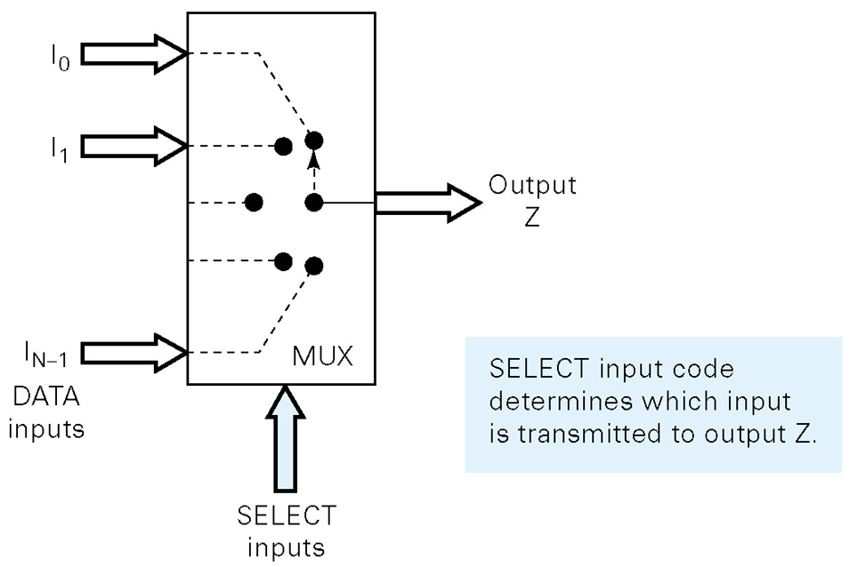
Functional diagram of MUX

Slide 5
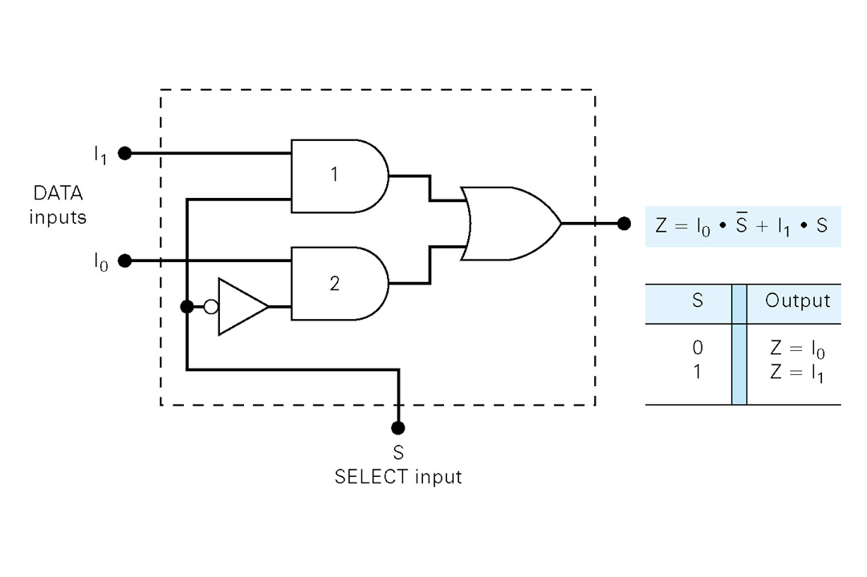
Two-input multiplexer

Slide 6
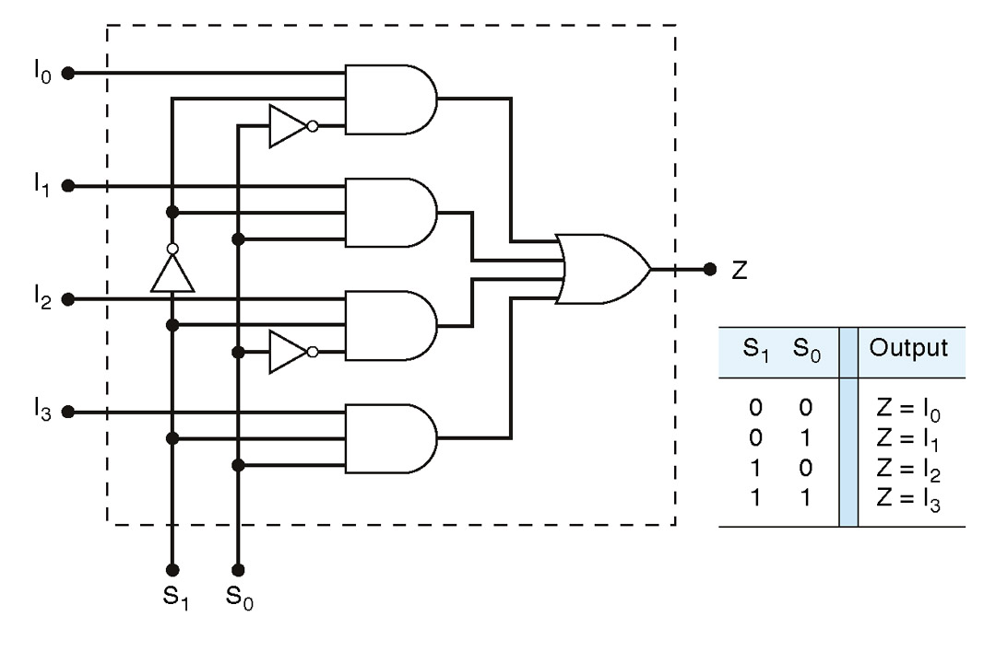
Four-input multiplexer

Slide 7
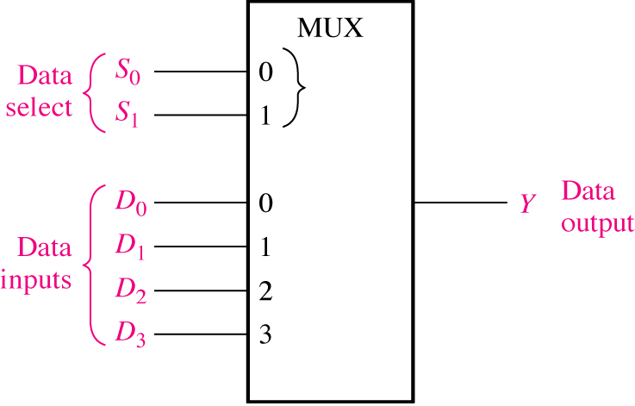
Logic symbol for a 1-of-4 data selector/multiplexer.

Slide 8
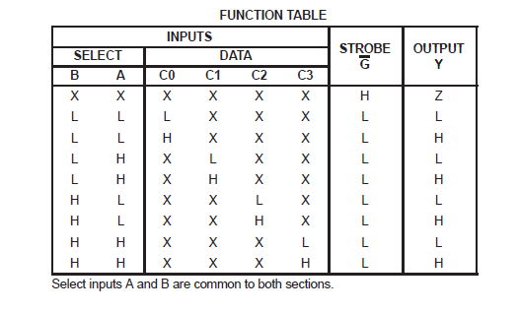
Logic symbol for a 1-of-4 data selector/multiplexer.
S1 S0

Slide 9
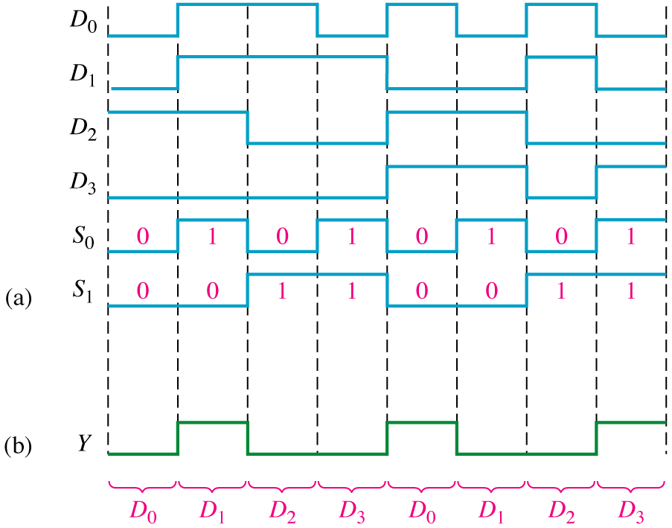
Output Waveforms in relation with the Data-Input and Data-Select waveforms - 4-input MUX
The binary state of the data-select
inputs during each interval
determines which data input
is selected. Here the data-select
inputs go through a repetitive
binary sequence 00,01,10,11,00,
and so on. The resulting output
waveform is shown.

Slide 10
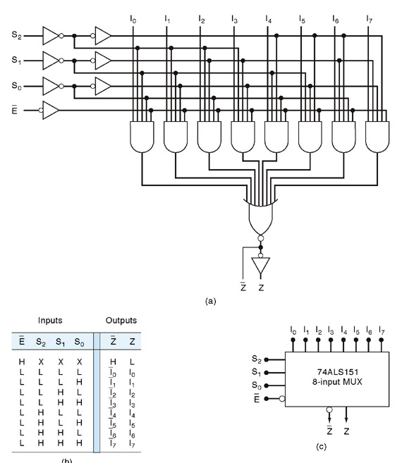
8-input multiplexer

Slide 11
MSI Quad Two−input Multiplexer
The 74LS157 contain of quad two−input multiplexers, I_{0a} I_{0b} I_{0c} I_{0d} and I_{1a} I_{1b} I_{1c} I_{1d}.
The logic symbol and truth table is shown in Figure.
Notice that each of the four multiplexer shares a common data select line and a common Enable.
Each multiplexer has only one data select input because there are only two groups of inputs to be selected.

Slide 12
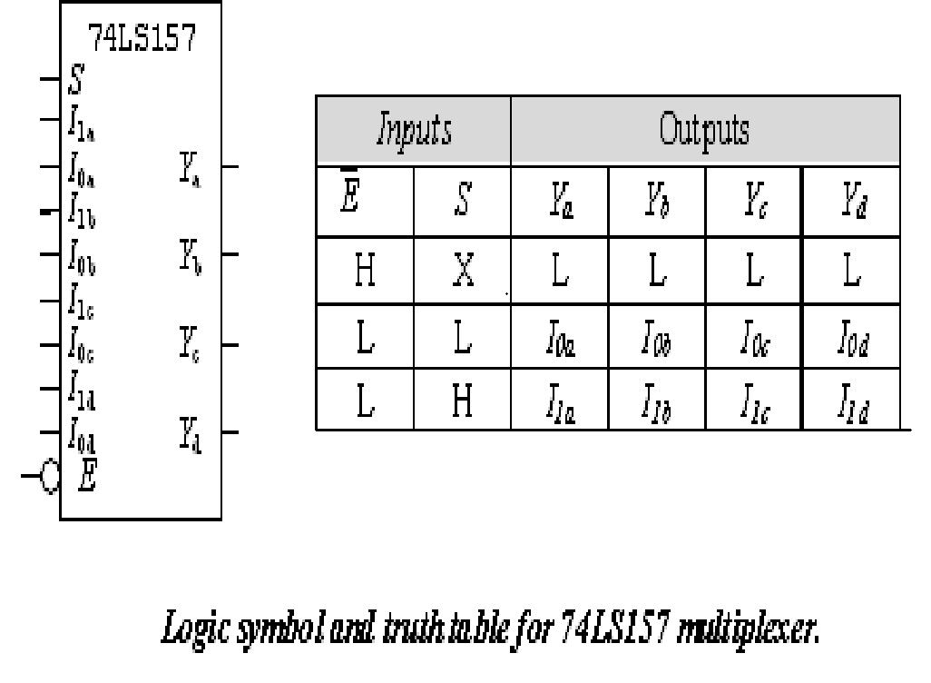

Slide 13
MSI Quad Two−input Multiplexer
Input is LOW − allows the selected input data to pass through to the output.
Input is HIGH − will disable the multiplexers, all of the outputs will be LOW.
When = 0 and S = 1, the Y outputs will follow the set of I₁ inputs, that is Y_{a} = I_{1a} , Y_{b} = I_{1b ,} Y_{c} = I_{1c,} and Y_{d} = I_{1d .}

Slide 14
LOGIC FUNCTION GENERATION USING MUX
Exercise 1:
Implement the logic circuit function specified in the table given below by using 74LS151 8-input data selector/multiplexer.
Input Output
A2 | A1 | A0 | Y
0 | 0 | 0 | 0 | 0
0 | 0 | 1 | 1 | 1
0 | 1 | 0 | 0 | 2
0 | 1 | 1 | 1 | 3
1 | 0 | 0 | 0 | 4
1 | 0 | 1 | 1 | 5
1 | 1 | 0 | 1 | 6
1 | 1 | 1 | 0 | 7

Slide 15
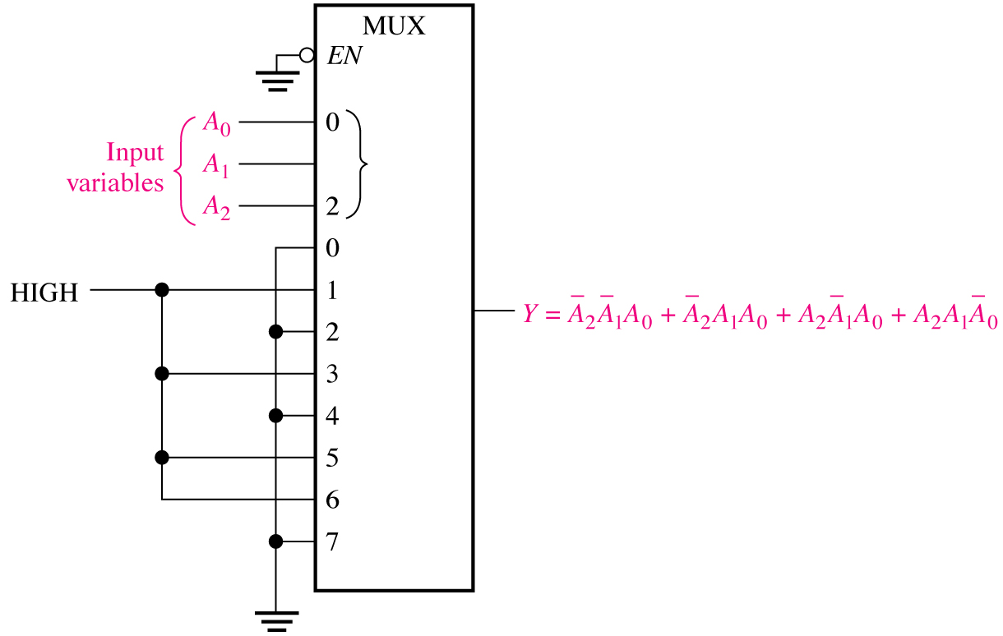
Solution :

Slide 16
LOGIC FUNCTION GENERATION USING MUX-Method
An efficient method for implementing a Boolean function of n variables with a MUX that has n-1 selection inputs and 2 ^{n-1} data inputs is given below:
  List the Boolean function in a truth table
  Apply the first n-1 variables in the table to the selection inputs of the MUX.
  For each combination of the selection variables, evaluate the output as a function of the last variable. This function can be 0,1, the variable, or the complement of the variable. Apply these values to the data inputs in the proper order.

Slide 17
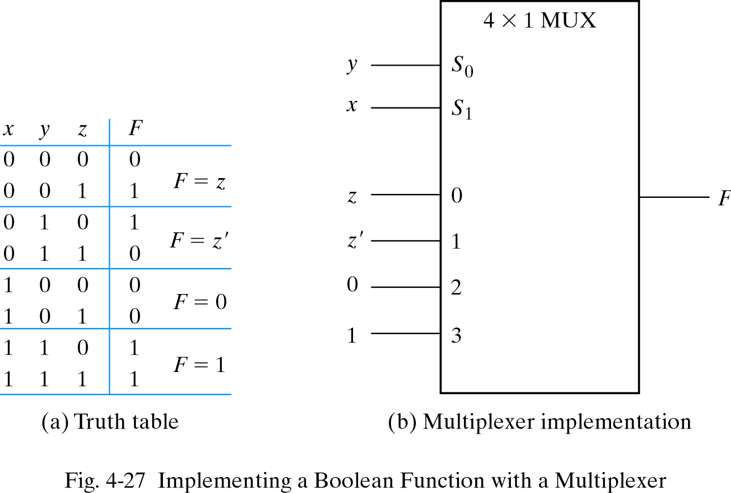
LOGIC FUNCTION GENERATION USING MUX-Example 2
Implement the Boolean function F=x’y’z +x’yz’ + xyz’ + xyz
using a suitable MUX
0
1
2
3

Slide 18
LOGIC FUNCTION GENERATION USING MUX-Example 2
The two variables x and y are applied to the selection lines in that order; x is connected to the S₁ input and y to the S₀ input.
The values for the data input lines are determined from the truth table of the function
  For ex., when xy=00, output F is equal to z because F=0 when z=0 and F=1 when z=1. This requires that variable z is applied to the data input 0

Slide 19
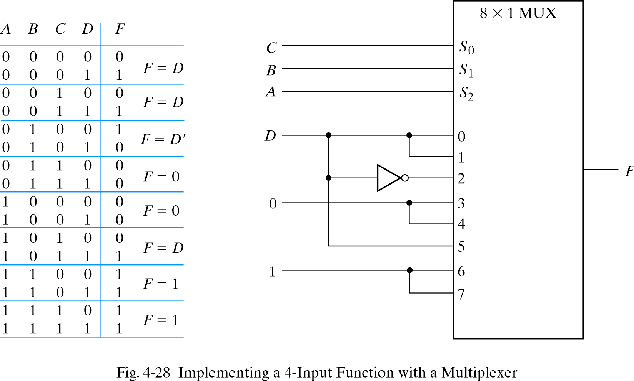
LOGIC FUNCTION GENERATION USING MUX-Example 3
Implement the Boolean function F=A’B’C’D+A’B’CD+A’BC’D’
+AB’CD+ABC’D’+ABC’D+ABCD’+ABCD using a suitable MUX
0
1
2
3
4
5
6
7

Slide 20
DEMULTIPLEXERS
A DEMULTIPLEXER (DEMUX) basically reverses the multiplexing function. It takes data from one line and distributes them to a given number of output lines. For this reason, the demultiplexers is also known as a data distributor.
A multiplexer takes several inputs and transmits one of them to the output.
A demultiplexer (DEMUX) performs the reverse operation ; it takes a single input and distributes it over several outputs.

Slide 21
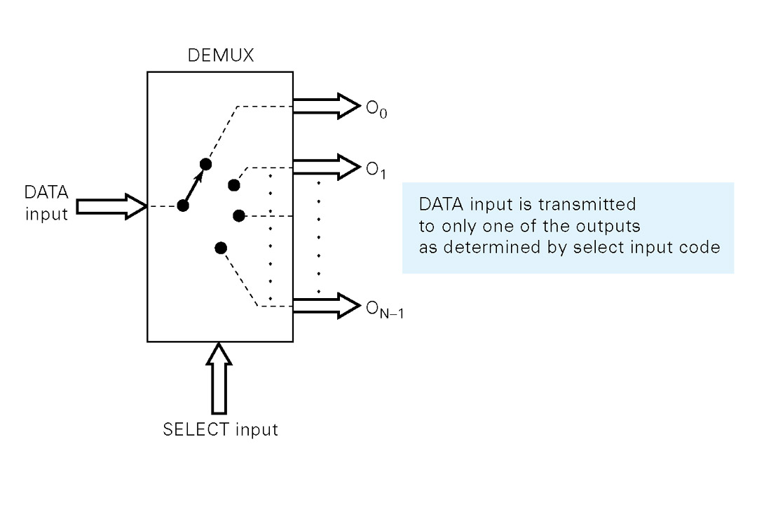
General demultiplexer
Functional diagram:-
The large arrow indicates one or more lines. The select i/p code determines to which output the DATA input will be transmitted
In other words, the demultiplexer takes one data input source and selectively distributes it to 1 of N output channels just like multiposition switch.

Slide 22
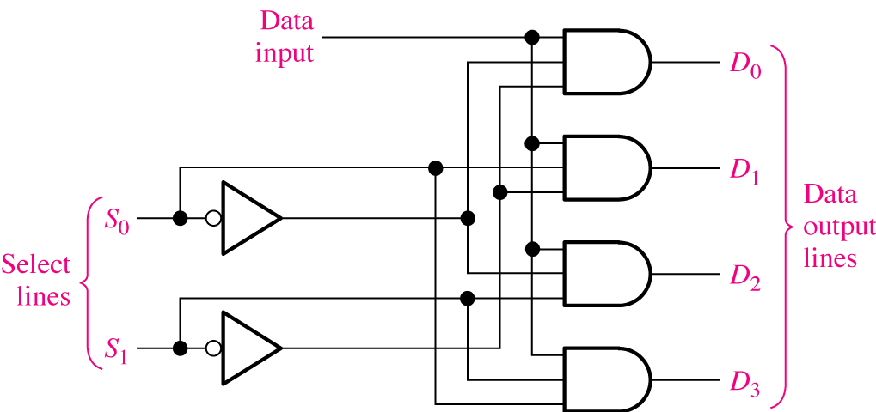
A 1-line-to-4-line demultiplexer.

Slide 23
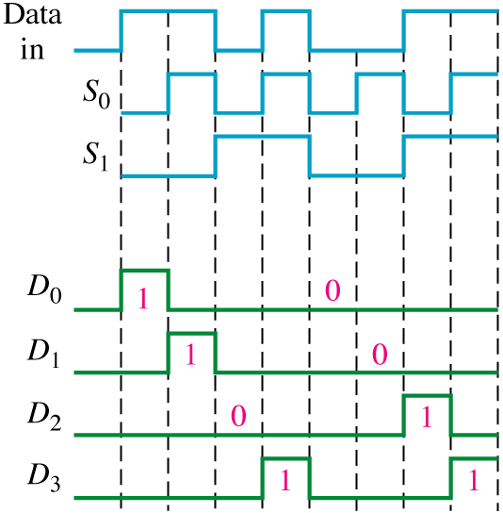
The serial data input waveform (Data in) and data select inputs (S_{o} and S₁) and
the corresponding data output waveforms (D₀ through D₃) are shown below

Slide 24
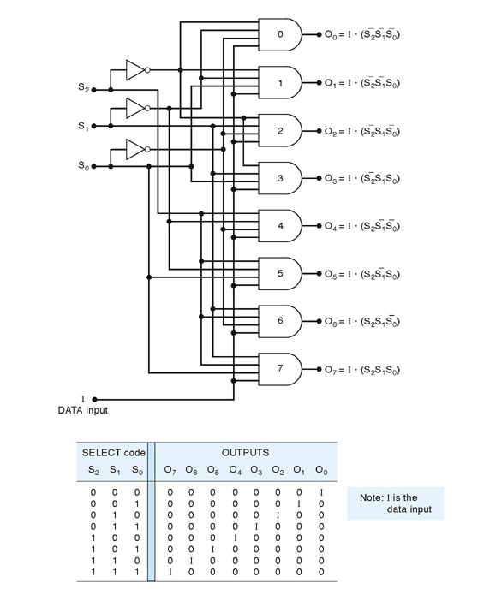
1-line- to-8 line demultiplexer

